Slide 1
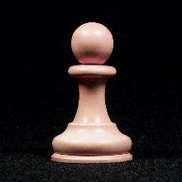
LANCASHIRE CHESS ASSOCIATION
This is to certify that
L
C
A
Oliver Bond
Has achieved the Pawn Standard in the LCA Junior Players Course
Dave Gaston - LCA Chief Junior Coach 14th Feb 2008

Slide 2
LANCASHIRE CHESS ASSOCIATION
This is to certify that
L
C
A
Rachel Greenwood
Has achieved the Pawn Standard in the LCA Junior Players Course
Dave Gaston - LCA Coach 14th Feb 2008

